Slide 1
Nuclear Fuel Performance
NE 533 Spring 2022

Slide 2
Last Time
Basics of what fuel performance means
Transfer of heat to the coolant
Operation without outages
Performance during off-normal scenarios
Intro to Nuclear Fuels
Considerations for fuels
Why not pure U?
Basics of UO2

Slide 3
Fuel types continued

Slide 4
Uranium-Zirconium (UZr)
Utilized in sodium cooled fast reactors (SFRs)
EBR I, EBR II
Varied crystal structure and compositional environment
Easily alloyed with Pu, minor actinides (MA)
Can function as a breeder/burner fuel
Sodium coolant
Fe-based cladding

Slide 5
Uranium-Zirconium (UZr)
Alloy metallic U with Zr to increase the melting point and to stabilize the high temperature body-centered cubic phase
Interesting phenomena
30-50% swelling
Constituent redistribution
Alpha tearing
FCCI

Slide 6
Uranium-Zirconium (UZr)
Good Characteristics
High thermal conductivity
Stability to high burnups (> 20%)
Flexible composition
Inherent safety- negative reactivity feedback
Good compatibility with Na coolant
Bad Characteristics
Low melting point
Dramatic fuel swelling that must be accounted for
Incredibly complex microstructures/unpredictable behavior
Fuel-Clad Chemical Interaction
Very easily oxidized

Slide 7

Uranium-Molybdenum (UMo)
New fuel being qualified for research reactors
Fuel foil, with Zr diffusion barrier, Al cladding
Will be utilized in ATR, NBSR, MITR, MURR

Slide 8
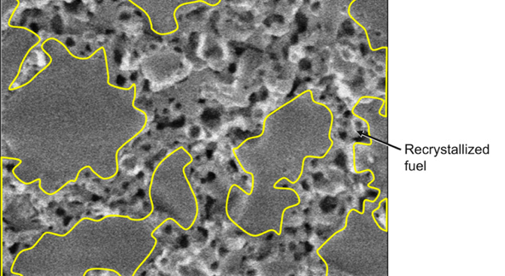
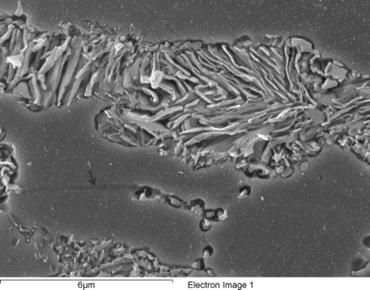
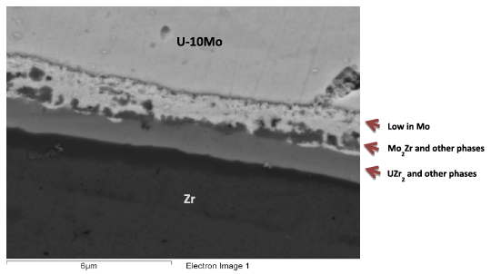
Uranium-Molybdenum (UMo)
Microstructural phenomena of interest:
Decomposition
Fission Gas Superlattice
Recrystallization
Inter-diffusion region
Carbides

Slide 9
UC/UCO TRISO Fuels
TRISO: TRistructural ISOtropic particle fuel
Layered fuel in mm-sized particles
Layers:
Fuel Kernel
Buffer
Inner Pyrolitic Carbon (IPyC)
SiC
Outer Pyrolitic Carbon (OPyC)

Slide 10
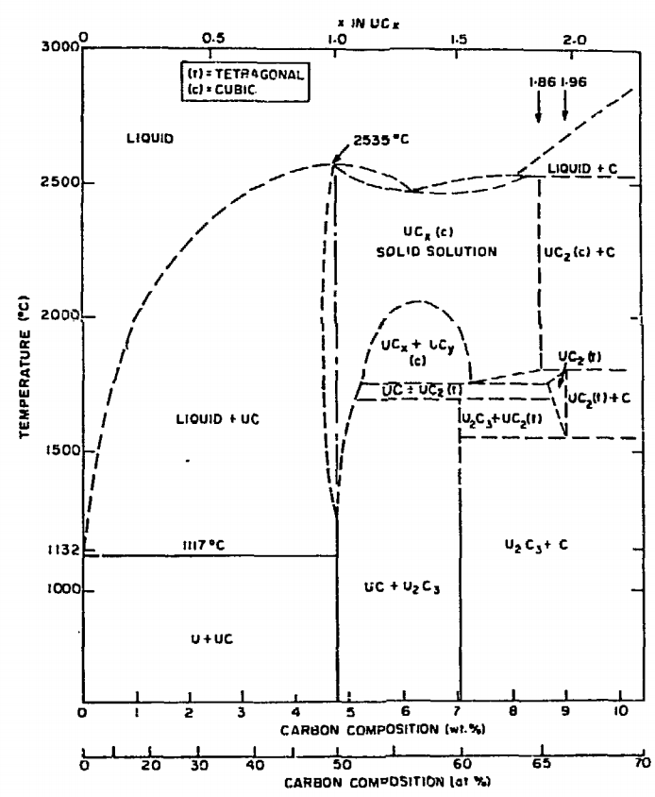
UC/UCO TRISO Fuels
Can appear as UC, U₂C₃, or UC₂
Advantages
High thermal conductivity
High fuel density
Thermally stable
High melting temperature
Disadvantages
Rapidly corrodes in water
Reacts with some cladding

Slide 11
UC/UCO TRISO Fuels
High temperature gas reactors (HTGR) or molten salt reactors (MSRs)
Pebble bed and prismatic types
Particles are agglomerated with graphite into a larger pebble, or into a cylindrical block
Current designs utilize UCO, which is a heterogeneous mixture of UO2 and UC fuel
Helium cooled gas or molten salt cooled

Slide 12
UC/UCO TRISO Fuels
Each individual pebble acts as its own containment, and allows fuels to go to much higher burnups and higher temperatures than UO2
Highly reliant on accurate fabrication processes that create high integrity, uniform layers and spherical particles
Integrity of the SiC is key for fission product retention

Slide 13
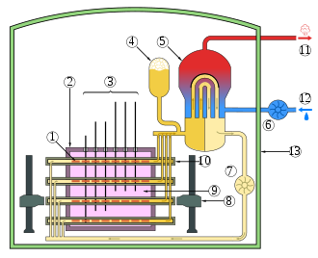
CANDU Reactors
Canada Deuterium Uranium: pressurized heavy water reactor
Natural uranium, as UO2, as the fuel source
Heavy water is the coolant, has a lower absorption of neutrons
Fuel pins are horizontal, as opposed to vertical
CANDU can be refueled online
Removes costs associated with enrichment

Slide 14
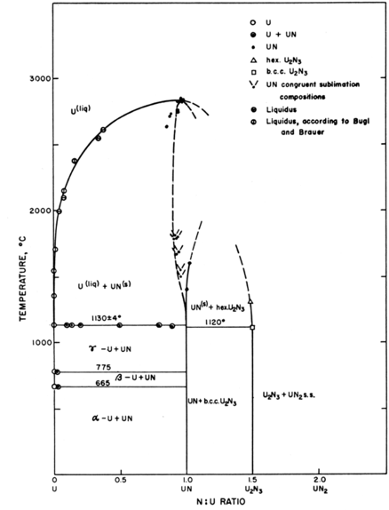
UN – Lead Cooled Reactors
Can appear as UN, U₂N₃, or UN₂
Advantages
High thermal conductivity
High fuel density
Thermally stable
High melting temperature
Disadvantages
Corrodes in water
Reacts with some cladding
Difficult to manufacture
Requires N-enrichment

Slide 15
Stable Salt Reactor
Utilizes fuel that is dissolved in molten salts
NaCl-(U/Pu)Cl3
Liquid fuel is contained in rods/assemblies
Molten salt coolant (NaF-ZrF, FLiBe, FLiNaK, etc.)
Can mix other actinides into the fuel in order to burn waste
Designed to be inherently safe
Molten salt corrosion is a big problem, as well as the lack of information on thermophysical properties of complex salt

Slide 16
Unique Fuel Designs
Lightbridge
High Zr content UZr alloy
Cruciform geometry fuel rods, combined into fuel elements
Kairos
TRISO particle compacts with low density core
Float in molten salt coolant for online refueling
NASA/LANL
UMo fuel for space reactors: KRUSTY

Slide 17
Fuel Summary Table
Property | UZr | UO₂ | UC | UN | U₃Si₂
Corrosion resistance in water | Very poor | Excellent | Very poor | Poor | Poor
Compatibility with clad materials | Reacts with normal clad | Excellent | Variable | Variable | Variable
Thermal stability | Phase change at 665 and 770 °C | Good | Good | Good | Good
Uranium (metal) density (g/cm³) | 19.04 | 9.65 | 12.97 | 13.52 | 11.31
Melting point (°C) | 1132 | 2865 | 2850 | 2860 | 1665
Thermal conductivity (W/m-K) | 38 at 430 °C | 3 at 1000°C | 25 at 500°C | 20 at 750°C | 23 at 773°C

Slide 18

Fuel Types Summary
There exist a number of nuclear fuels in different stages of utilization and development
Each reactor design or application has individual needs, and no one fuel is one size fits all
Need to balance safety, performance (normal, off-normal, extended), manufacturability, processing, waste, etc.

Slide 19
Summary
Uranium is combined with O, C, N, transition metals for a variety of fuel types
UO2: ceramic, commercial reactor fuel, light water reactors
ATF: U3Si2 and Cr-doped UO2
UZr: fast reactor fuel
UMo: research reactor fuel
UC/UCO: high temperature gas reactors

Slide 20
Reactor systems

Slide 21
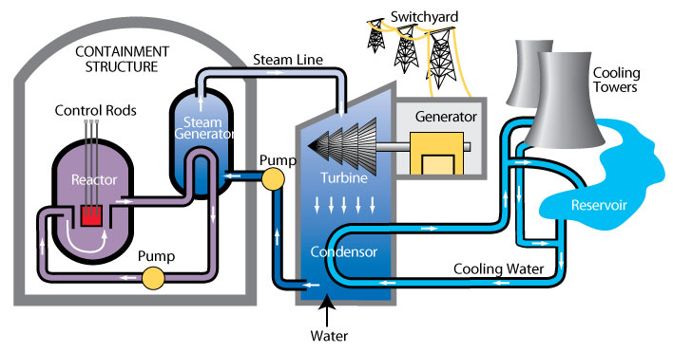
Heat removal systems
Now we touch on how heat is removed from the fuel
Primary mechanism to remove heat directly from fuel is a coolant
Various coolant types, most common is water

Slide 22
Heat removal systems
Primary loop water runs through the core, transporting heat generated by the fuel, to a steam generator in a secondary water loop
Steam drives a turbine, generating electricity
A tertiary water loop helps to condense residual steam from the secondary loop via cooling towers and a water reservoir

Slide 23
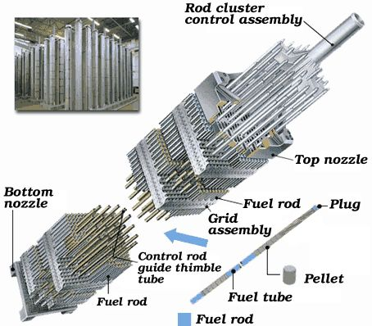
Light Water Reactor Core Design
An LWR core is comprised of fuel assemblies
Each assembly contains a grid of fuel pins
In typical commercial LWR fuel designs, a 17x17 grid
Some pins are replaced by control rods
Water flows from bottom to top

Slide 24
LWR Fuel Pins
LWR fuel pins are comprised of a hollow Zircaloy tube
This is the cladding
Zircaloy is a type of Zr alloy
Inside the cladding are stacked UO2 pellets
Each pellet is a cylinder about 1 cm in diameter and 1 cm in height

Slide 25
Not only water-cooled reactor designs

Slide 26
Not all fuel is pellet-based
Metallic fuel is a solid fuel slug
Utilized an Fe-based cladding, such as HT-9 or SS
TRISO particles are formed into spherical compacts, or can be formed into pellet compacts
UMo and USi have been used in plate fuels
Assemblies are often hex-shaped and can included reflectors

Slide 27
ATR and HFIR Core design
HFIR combines curved plates in concentric regions
The ATR core is a unique curved design with plate type fuel

Slide 28
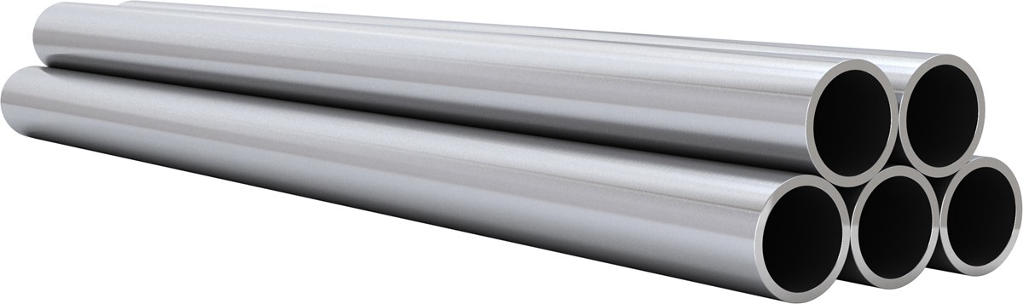
Most fuel designs employ some type of cladding
The primary focus of the cladding is to separate the fuel from the coolant
Fuel contains radioactive fission products
Avoids corrosion of the fuel by the coolant
Keeps the fuel together, not blocking coolant flow
The cladding should be thin and have a high thermal conductivity, so it doesn’t trap any of the heat produced by the fuel
Cladding should also be neutron transparent

Slide 29
Fuel/Cladding Gap
Fuel swells during reactor operation and the cladding creeps down around the fuel
To avoid/limit both chemical and mechanical interaction, the pellet radius is smaller that the inner radius of the cladding
In LWRs, the gap is filled with gas, significantly impacting the heat transport
In metal fuels, the gap is filled with liquid sodium, so there is little impact on the heat transport

Slide 30
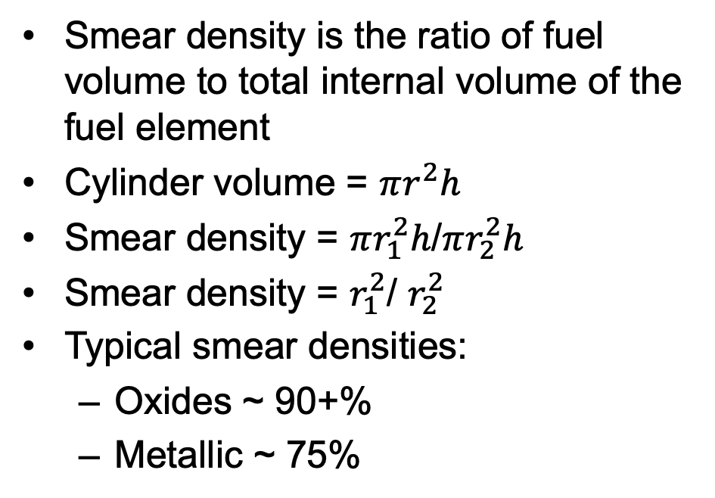
Smear Density
Smear density is the ratio of fuel volume to total internal volume of the fuel element
Cylinder volume = $πr^{2}h$
Smear density = $πr_{1}^{2}h$/$πr_{2}^{2}h$
Smear density = $r_{1}^{2}$/ $r_{2}^{2}$
Typical smear densities:
Oxides ~ 90+%
Metallic ~ 75%
r1
H
r2

Slide 31
Cladding material selection
Cladding must be compatible with the coolant, reasonably compatible with the fuel, have good thermal conductivity and reasonable radiation resistance
Zirconium is used because of its
Low neutron cross section
Corrosion resistance in 300 C water
Resistance to void swelling
Adequate mechanical properties
Good thermal conductivity
Affordable cost
Available in large quantities
Other cladding materials in use include
Stainless steel
Silicon Carbide
Ferritic-Martensitic steels like Fe-Cr and Fe-Cr-Al
Oxide dispersion strengthened (ODS) ferritic steels

Slide 32
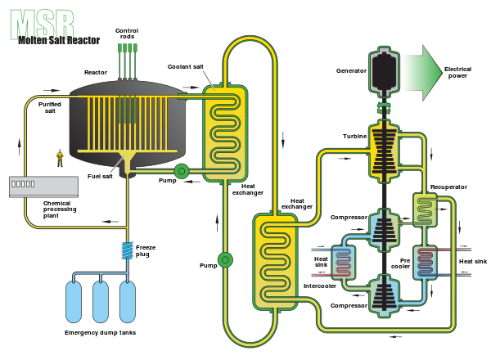
Molten Salt Reactors w/o cladding
Some MSRs plan to utilize liquid molten salts as the fuel, flowing continuously through the core
Secondary loop comprised of coolant salt, such as FLiBe
Example was the MSRE from ORNL, which utilized LiF-BeF2-ZrF4-UF4 as the fuel
Cladding is the flow piping

